Slide 1
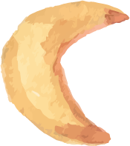
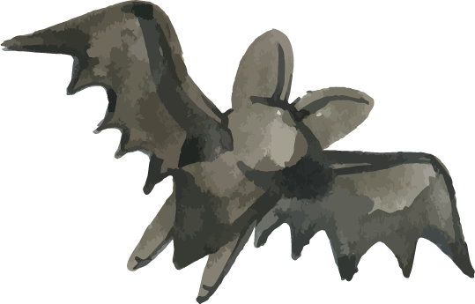







Google Developer Group(GDG)
Workshop
California State University Long Beach
Video Game Development Using Phaser

Slide 2
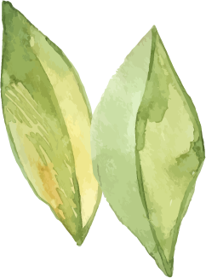

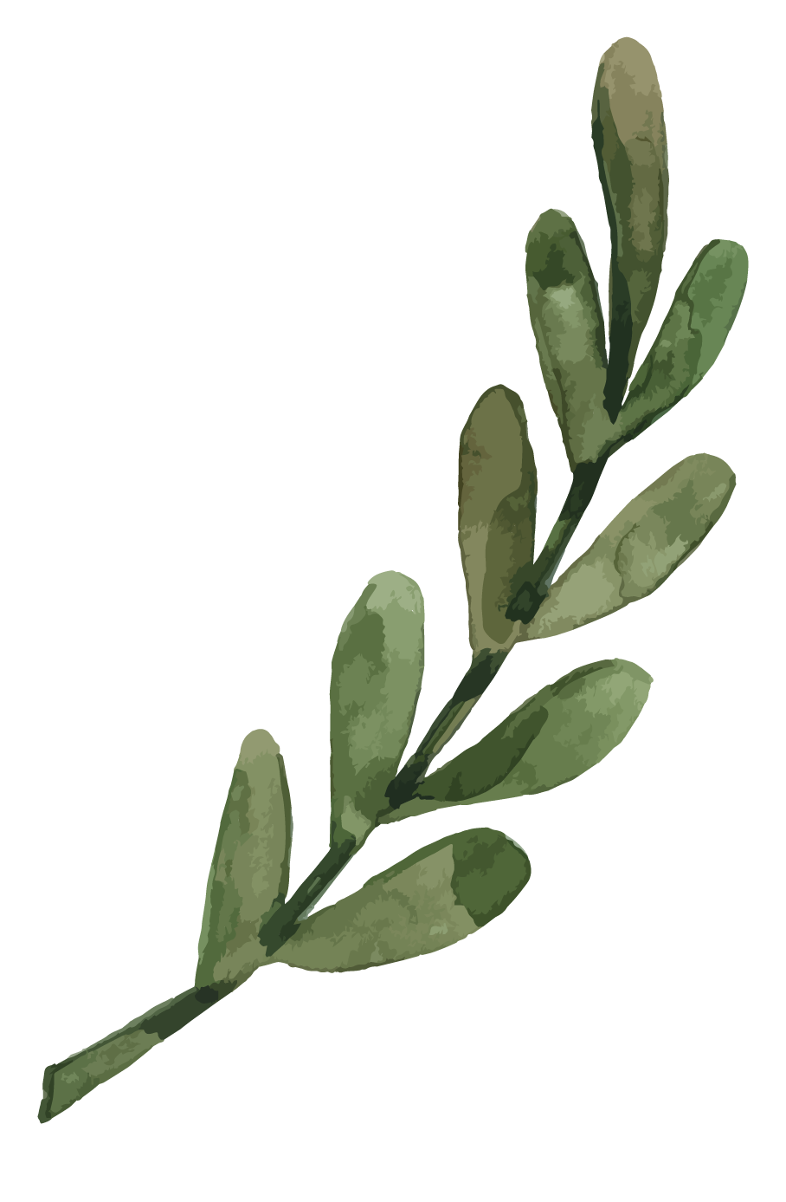


Phaser
What is Phaser?
Phaser is a fast, free, and fun 2D game framework for making HTML5 games for both desktop and mobile web browsers.
It is an open-source JavaScript/TypeScript framework developed by Photon Storm and has a massive, active community.
It handles the difficult parts of game development (like rendering, physics, and input) so developers can focus on the game logic.
It supports both WebGL and Canvas rendering and automatically selects the best option for the user's browser for optimal performance.

Slide 3

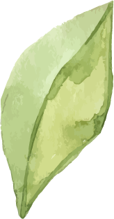

Follow this Short Tutorial
Notes:
Tutorial link: https://www.youtube.com/watch?v=yP5DKzriqXA

Slide 4
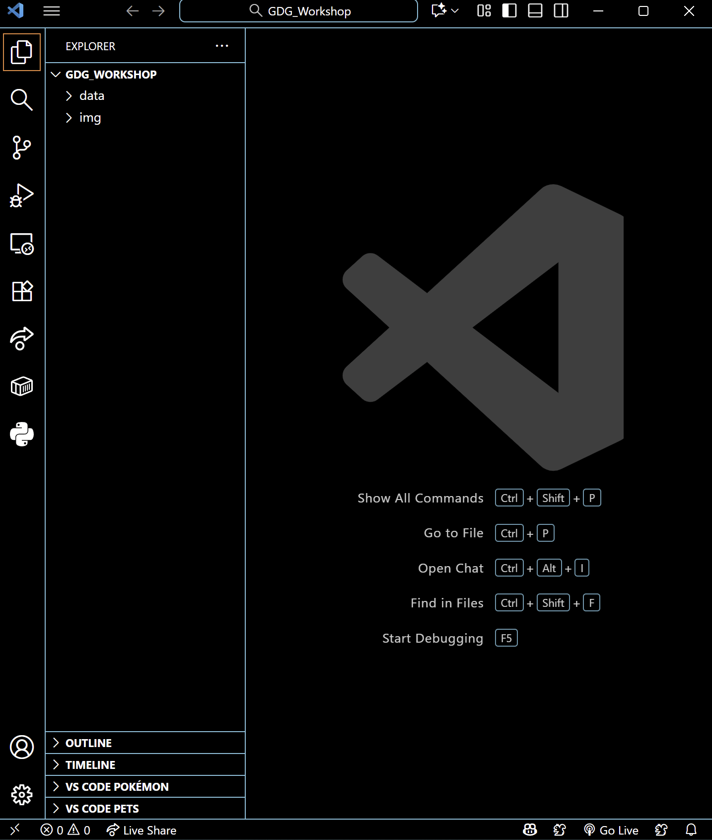
Phaser
Unzip the “GDG_Workshop” started code and open it on VSCode

Slide 5
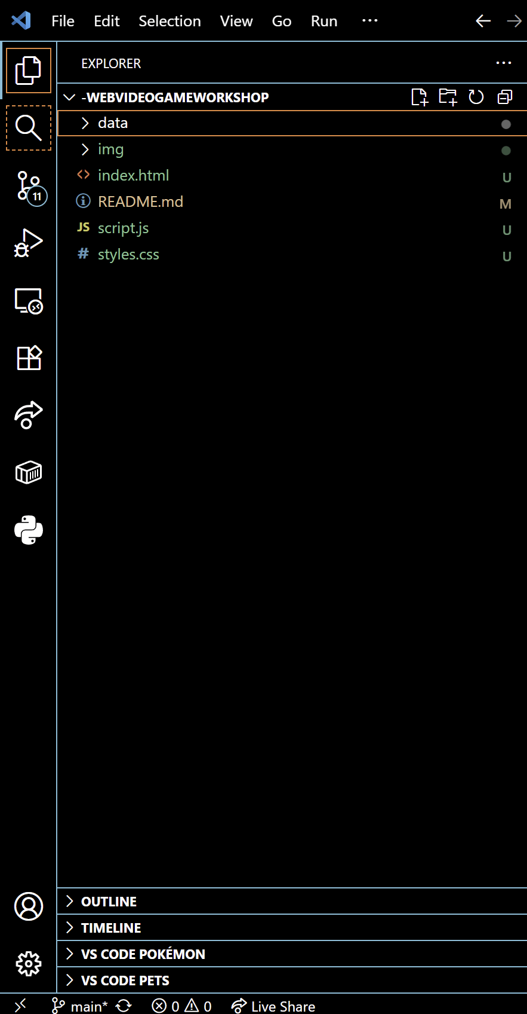
Create an “index.html”, “script.js”, and “styles.css”

Slide 6
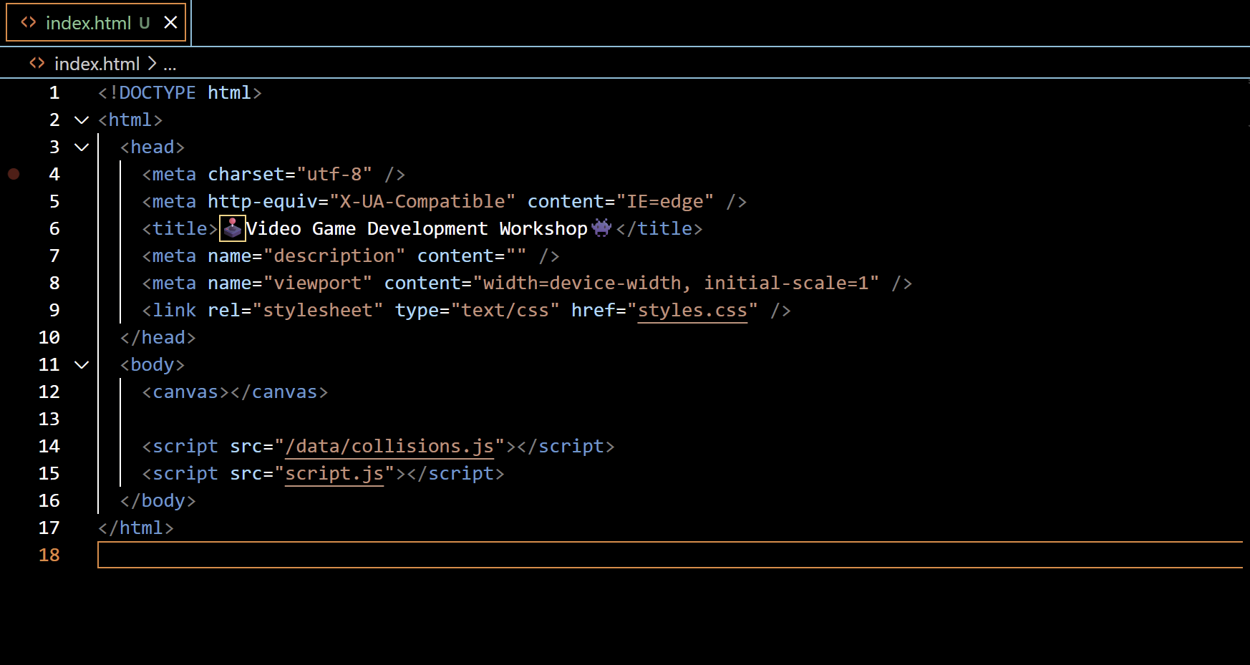
Index.html - Structure
We have to write out html this way to create the main layout of the Canva Game Screen

Slide 7
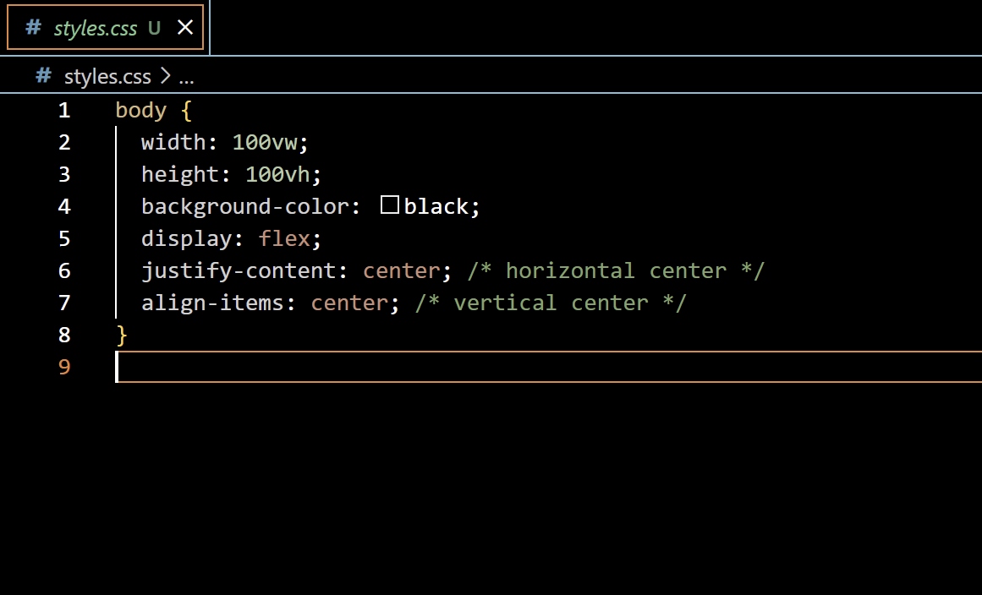
Styles.css - Structure
The css stylesheet, we are adding only centering to the canva Game screen

Slide 8
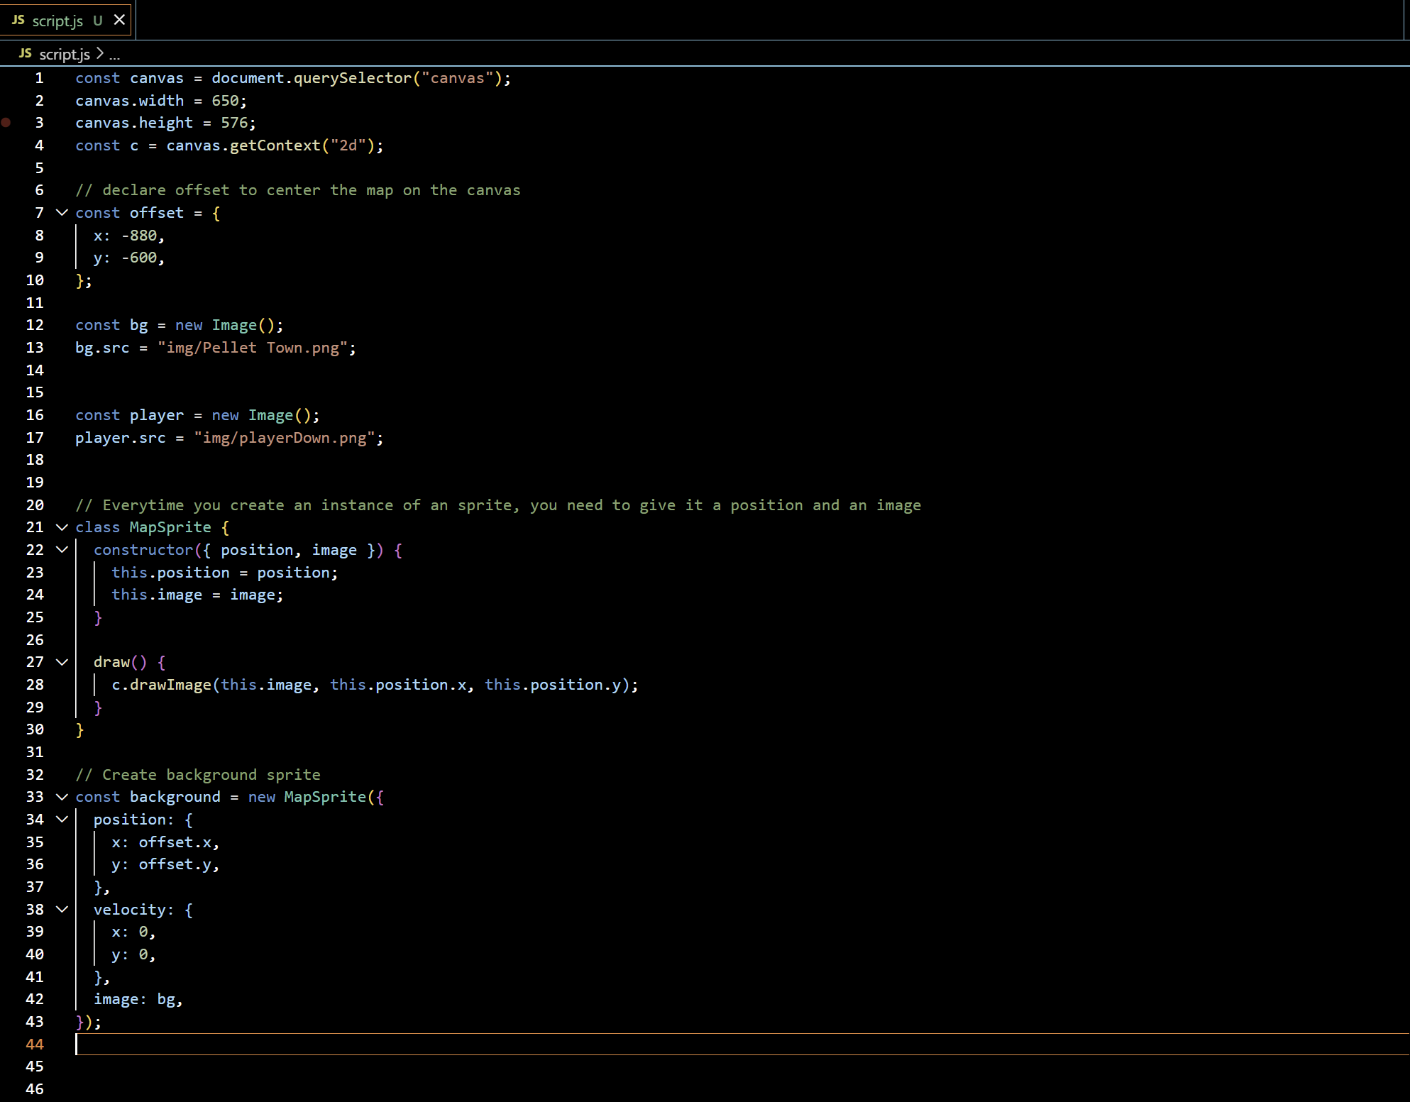
Declare Game Sprites
We will select our game sprite’s pngs and create a sprite object to render the map and declare the map

Slide 9
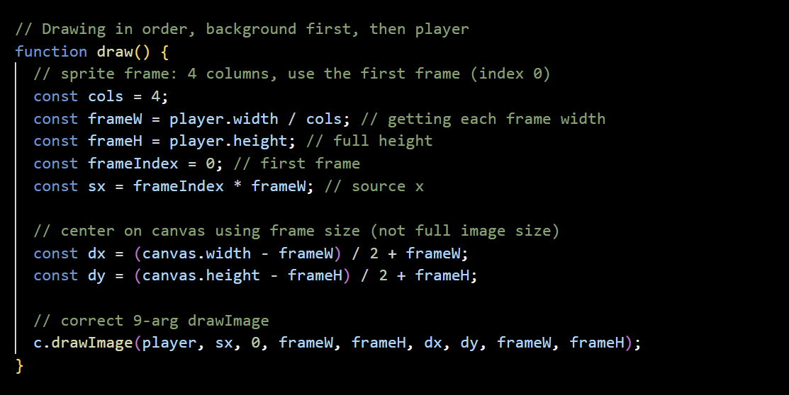
Draw function for player
We will create a Draw function for our player to render on the center of the map

Slide 10
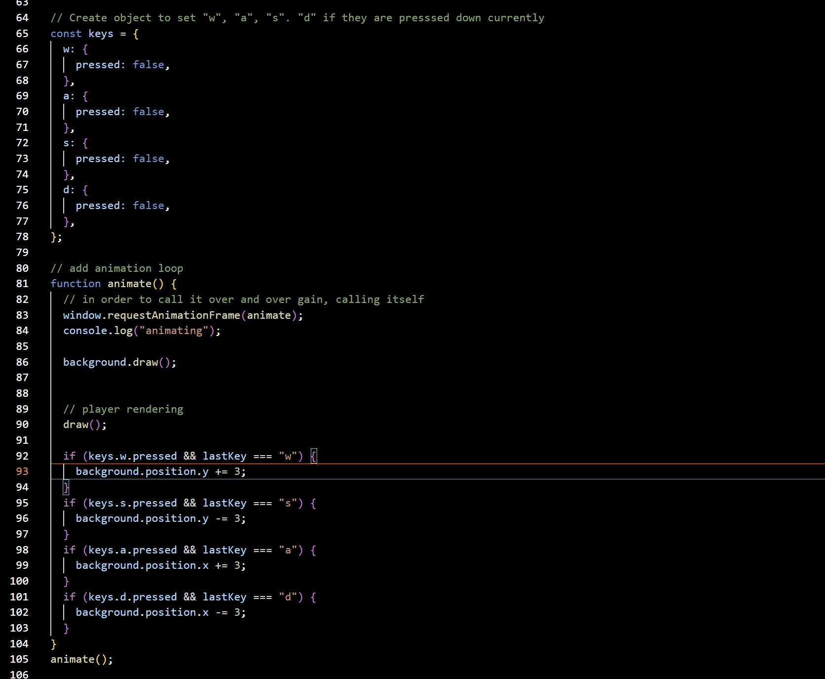
Player Movement logic
We create an object to track which movement keys are currently pressed. Next, we define an animate() function that continuously updates the game using requestAnimationFrame(). This loop redraws the background and updates the player’s position and animation each frame, creating smooth movement.

Slide 11
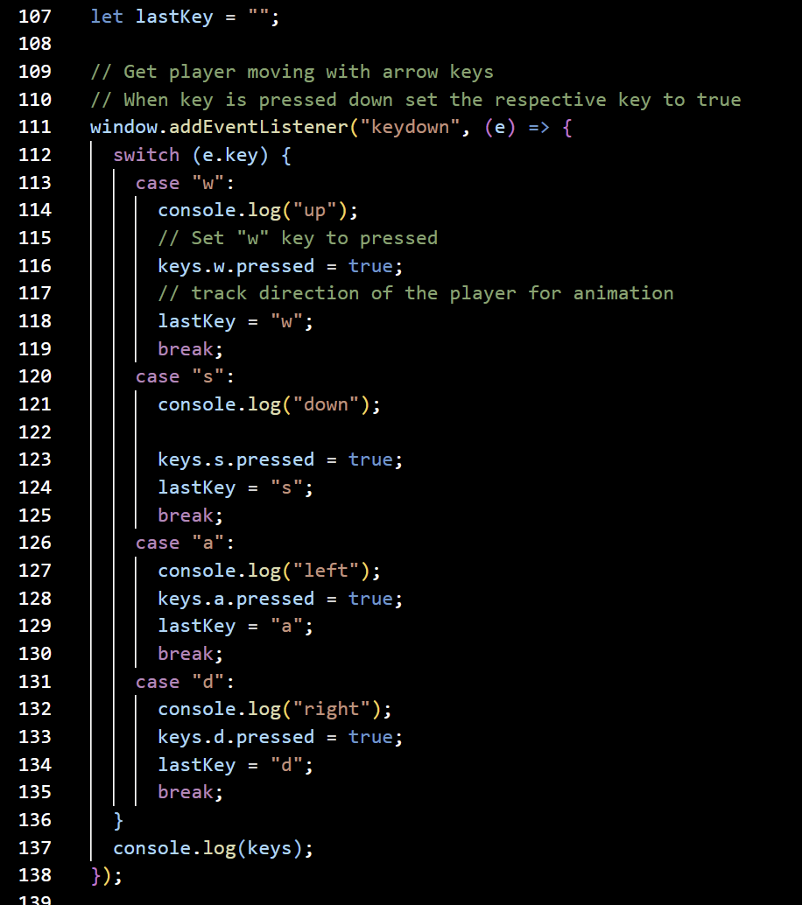
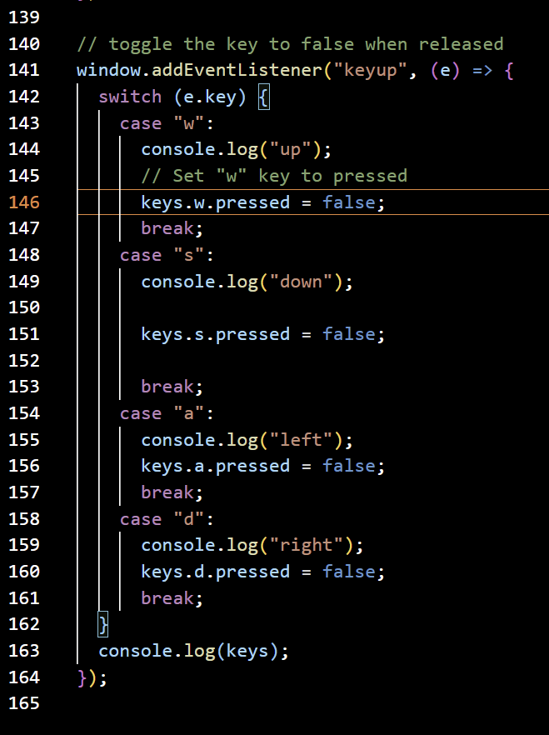
Movement - Keypress Logic
We add event listeners for key presses to detect which movement key the player is currently holding down. When a key is pressed (keydown), the corresponding property in our keys object is set to true, and we store the direction in lastKey for animation control. When the key is released (keyup), that property is toggled back to false, marking the key as inactive. This allows continuous movement while a key is held and stops movement when it’s released.

Slide 12
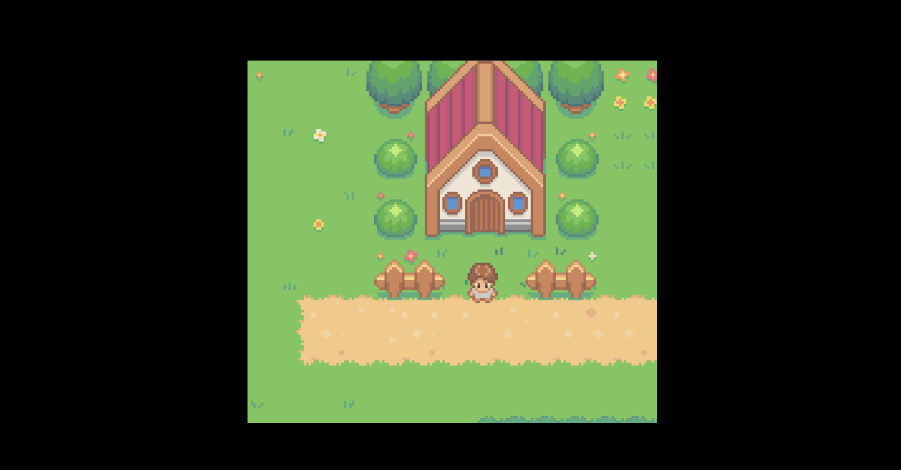
Now you can move your player and continue building the logic!

Slide 13

Stay tuned & get active!
Follow our socials:

Slide 14
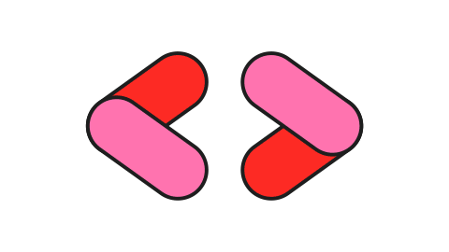
Thank You!
On Campus - California State University, Long Beach

